Slide 1
E15
Recitation 3

Slide 2
What is E15?
A simplified learning language that mimics assembly language
4 registers (4-bit each)
Program counter (4-bit)
Zero flag (1-bit)
An E15 program will contain 16 instructions from myROM[0] to myROM[15]

Slide 3
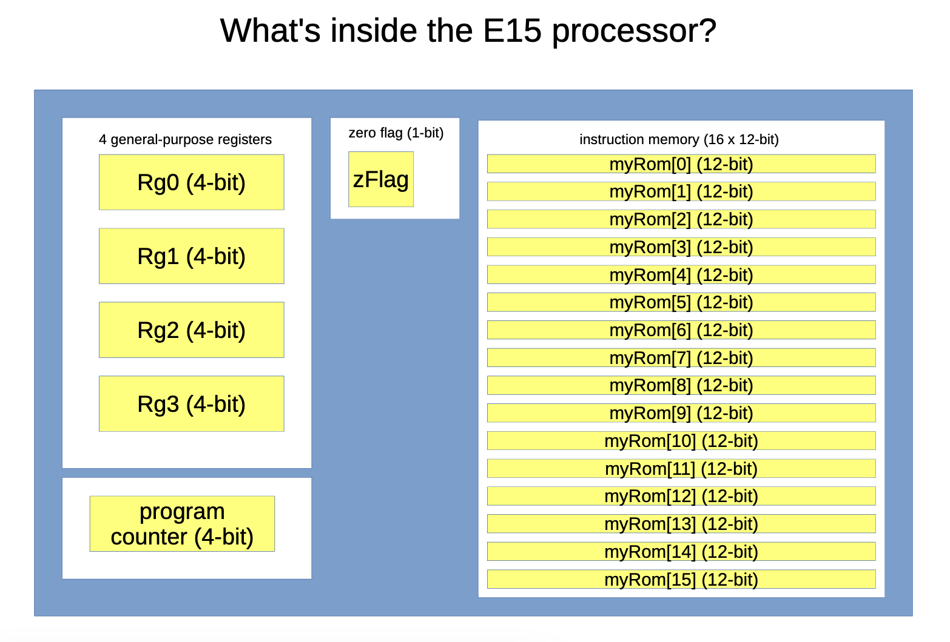

Slide 4
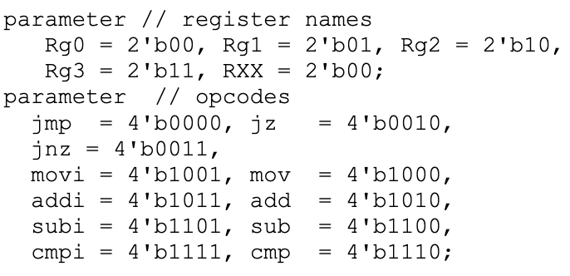
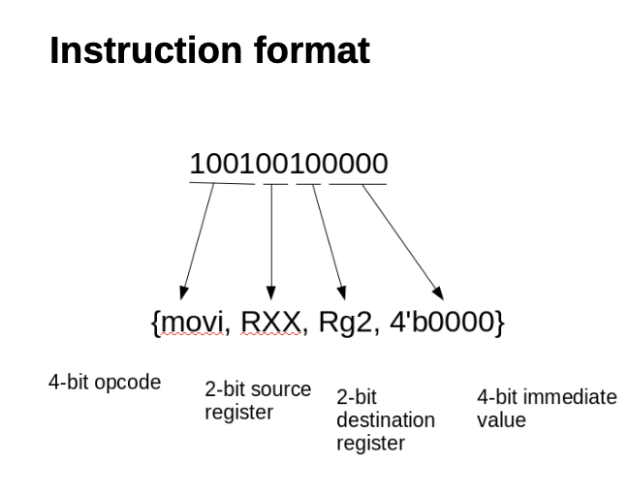
Instruction format

Slide 5
Examples
Describe what each E15 instruction does. Include any effect on the registers, zero flag, or program counter:
{mov, Rg3, Rg1, 4’b0000}
{addi, RXX, Rg2, 4’b0101}

Slide 6
How do we know when an E15 program has ended?
Infinite loop/jumping to the same instruction constantly

Slide 7
Useful things to know for exercises
If the sum of operations is zero, the zero flag is set
e.g {sub, Rg0, Rg0, 4’b000}
Registers wrap around when they underflow and overflow
Program counter wraps around when it overflows

Slide 8
Advice
USE THE E15 CHEAT SHEET ON THE GUIDES

